Slide 1
“Strategic focus and alignment”: UHC2030’s vision and offer
UHC2030 Steering Committee, 12-13 December 2018

Slide 2
Questions for this session
1) What is UHC2030’s unique “offer” in support of accelerated progress towards UHC?
2) What are the priority issues and activities for UHC2030 to deliver this offer – and what does it mean for ways of working?

Slide 3
Agenda
Session | Topics
Thursday
1030-1230 | The unique UHC2030 “offer” Vision & goal level “changes we want to see” The UHC2030 “offer” Group work – “things I want from UHC2030 in 2019”
1330-1630 | Relating this offer to priorities How UHC2030 works for countries [break 1445-1515] Role for civil society SDG3 Global Action Plan Implications & decision-points
Friday
(0900-1030) | (HLM-UHC preparations)
1100-1200 | How we implement the offer – decisions
(1300-1430) | (UHC2030 Working Arrangments)
(1430-1515) | (Workplan & budgets)

Slide 4
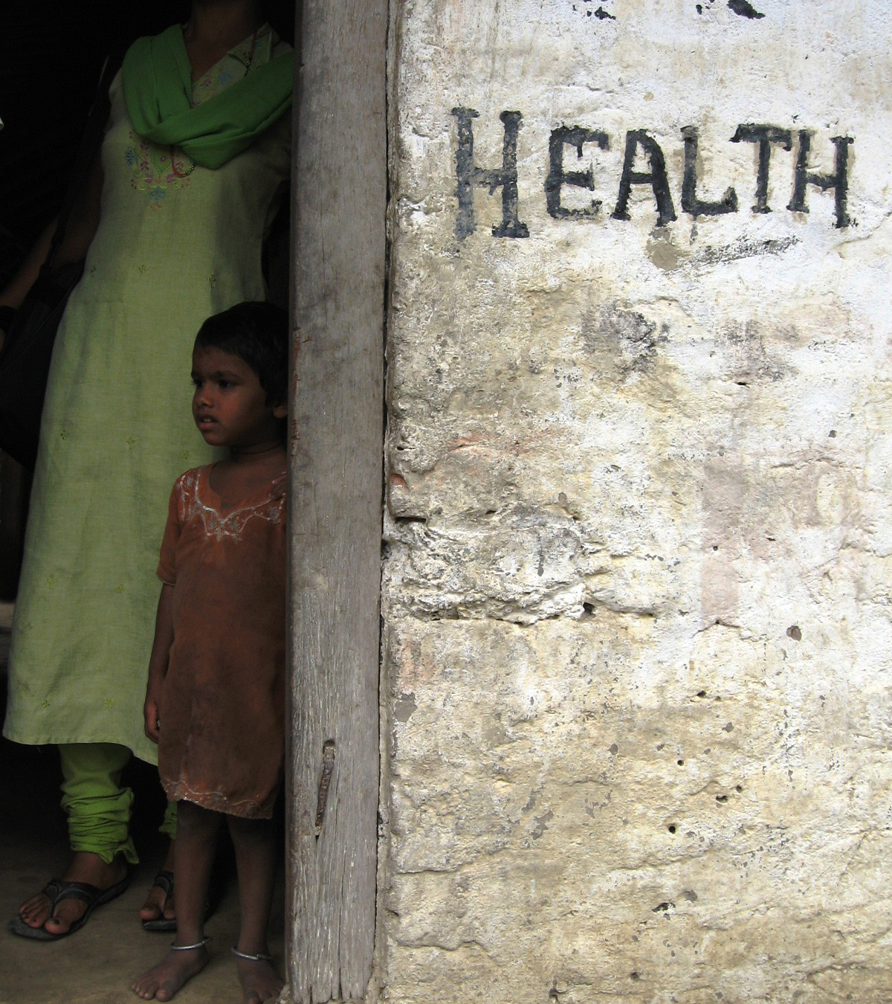
We want to see…
More resources for UHC (domestic and external)
Better (more efficient and effective) use of all resources for UHC
More coherent action across all partners
...to drive faster, more equitable and sustainable progress towards UHC

Slide 5
5 underlying principles
(Global Compact & Joint Vision)
Leave no one behind. Stronger national and international commitments and action for UHC, focused on meeting the needs of all people in all settings.
Transparency and accountability for results. Governments and partners held to account at all levels for UHC progress, including through effective advocacy.
Evidence-based national health strategies and leadership. Good quality strategies/plans enable more effective use of all resources for UHC. International partners work together better, and respect and foster country leadership.
Health systems are everybody’s business. Full recognition of the roles, and effective engagement, of all partners within and beyond the health sector – including civil society and the private sector.
International cooperation based on mutual learning & effectiveness. Stronger networks and dialogue for sharing knowledge and experience of effective health systems strengthening approaches.

Slide 6
“Changes we want to see”
Leave no one behind. Stronger national and international commitments and action for UHC, focused on meeting the needs of all people in all settings.
Transparency and accountability for results. Governments and partners held to account at all levels for UHC progress, including through effective advocacy and social accountability.
Evidence-based national health strategies and leadership. Good quality strategies/plans enable more effective use of all resources for UHC. International partners work together better, and respect and foster country leadership.
Health systems are everybody’s business. Full recognition of the roles, and effective engagement, of all partners within and beyond the health sector – including civil society and the private sector.
International cooperation based on mutual learning & effectiveness. Stronger networks and dialogue for sharing knowledge and experience of effective health systems strengthening approaches.

Slide 7
“Changes we want to see” For (brief) Steering Committee discussion
Leave no one behind. Stronger national and international commitments and action for UHC, focused on meeting the needs of all people in all settings.
Transparency and accountability for results. Governments and partners held to account at all levels for UHC progress, including through effective advocacy.
Evidence-based national health strategies and leadership. Good quality strategies/plans enable more effective use of all resources for UHC. International partners work together better, and respect and foster country leadership.
Health systems are everybody’s business. Full recognition of the roles, and effective engagement, of all partners within and beyond the health sector – including civil society and the private sector.
International cooperation based on mutual learning & effectiveness. Stronger networks and dialogue for sharing knowledge and experience of effective health systems strengthening approaches.
Which areas are particularly relevant for UHC2030? (NB goal level changes we contribute to – do not claim attribution)
Is anything important missing?

Slide 8
UHC2030 must define its contribution more succinctly and be more concrete about what it offers and delivers.
(A High Income Country Health Adviser, constituency phone call, December 2018)

Slide 9
UHC2030 ‘offer’: UHC2030 convenes & makes connections to advance UHC
Bring together diverse voices, to influence national and international commitments, plans, action and accountability for UHC.
Voices for UHC
Working better together for UHC
Convene, build consensus and promote effective ways of working that address key health systems issues and bottlenecks.
Knowledge & networks for UHC
Make relevant knowledge and resources available and accessible, and promote sharing of evidence and experience.

Slide 10
1) “Voices for UHC” (Indicative work areas)
→ Global advocacy
Ensure meaningful engagement in, and outcomes from, the UN High Level Meeting on UHC.
Contribute to better-integrated accountability for SDG3.
→ CSO engagement
Build a civil society constituency for a strong equity-focused and people-led movement for UHC, for global and country-level advocacy.
Ensure CSOs are appropriately engaged in relevant global forums and processes, e.g. SDG Action Plan, G20, G7.
→ Political support and grass-roots demand
Provide a platform to coordinate and align UHC advocacy efforts across issues, countries, and sectors.
→ Social accountability
Incubate and promote guidance, tools and frameworks for country level accountability mechanisms

Slide 11
2) “Working better together for UHC” (Indicative work areas)
→ SDG3 Global Action Plan
[TBC] Convene for relevant ‘Accelerators’, help inform actions and ways of working, and support strengthened accountability, to accelerate progress towards UHC.
→ More effective health cooperation
Convene countries and partners to identify, agree, and promote ways of working that make investments in HSS more effective (building on IHP+).
→ Financing & sustaining coverage & quality
Secure consensus and provide guidance on different partners’ (countries, donors, GHIs, etc) roles in scaling up, managing, sustaining, and using all resources effectively for UHC.
→ UHC and vulnerable contexts
Convene, to agree and promote approaches to accelerate and safeguard UHC progress for vulnerable populations and contribute to health emergency risk management, especially in fragile states.
→ Private sector engagement
Convene and mobilise dialogue about private sector contributions towards UHC.

Slide 12
3) “Knowledge & Networks for UHC” (Indicative work areas)
→ UHC Knowledge Hub
Incubate an interactive online knowledge management system that connects country practitioners and policymakers with relevant products and services for HSS and UHC.
→ UHC2030 ‘network of networks’
Promote connections and collaboration across the ‘family’ of international HSS networks; provide a unique overview across networks and partnerships.
→ UHC2030 HSS resources
Maintain and promote HSS tools and resources, e.g. joint planning and assessment frameworks.

Slide 13
For Steering Committee discussion:
The UHC2030 offer
UHC2030 convenes and makes connections to advance UHC:
Voices for UHC
Working better together for UHC
Knowledge & networks for UHC
Is this articulation of the UHC2030 offer helpful?
a) To describe our work
b) To bring greater focus to what the partnership does?
Does it reflect areas of added value
What is UHC2030 best at doing?
What things does UHC2030 do better (or is better-placed to do) than other partner(ship)s?
Unpack global and country dimensions of the offer; what is the right balance?
NB will focus explicitly this afternoon on how UHC2030 works for countries

Slide 14
Group work (1200-1230)
“What do I want from UHC2030 in 2019?”
Split into 4 groups (flipcharts in room)
Nominate a scribe and a rapporteur
As a group, discuss concrete things you want to see from UHC2030 in 2019, i.e. what we do and what success looks like.
Frame under the offer headings (& think about how it helps countries):
Voices for UHC
Working better together for UHC
Knowledge & networks for UHC
Report back after lunch.

Slide 15
Afternoon agenda: Strategic focus & alignment
Reflections from this morning (c.15min)
Co-chairs reflections on morning discussions
Group work feedback: “What do I want from UHC2030 in 2019?”
2) What does the UHC2030 offer mean for countries? (1345-1445)
[Coffee break 1445-1515]
3) SDG3 Global Action Plan (1515-1615)
Update from Civil Society consultation
Potential UHC2030 contributions to GAP
4) Homework: things to think about overnight

Slide 16
UHC2030 works for countries, but not (directly) in countries”
[VOICES] How does UHC2030 support better decision-making and accountability at country level?
[WORKING BETTER TOGETHER] How does UHC2030 support better ways of working at country level?
[KNOWLEDGE & NETWORKS] How does UHC2030 ensure knowledge & networks support country priorities?

Slide 17
Example: UHC2030 accountability work
Package/tools for capacity strengthening on health budget advocacy (CSOs, parliaments, media, MoH, MoF, academia)
Promote coherence; foster collaboration; improve execution; global public good.
Learning, exchange & guidance on social participation for UHC
Collaborative (under Health System Governance Collaborative); advance sensitive issues; feed into WHO Handbook; advocate.
Support to countries to strengthen health component of SDGs follow-up & review mechanisms; & link with sector processes
Voluntary National Review pilots – Ghana. (Develop supporting guidance?)
Advocacy on importance of accountability (inc. social participation)
CSEM shadow UHC monitoring report (HLPF/HLM-UHC).
Messaging/events to mobilise political support

Slide 18
Indicative UHC2030 offer for countries – to discuss
VOICES
Global advocacy
Convene & involve countries – make advocacy relevant, escalate concerns.
Civil society
Build civil society constituency, incl. for country-level advocacy.
Social accountability
Incubate and promote guidance, tools and frameworks for country level accountability mechanisms
WORKING BETTER TOGETHER
SDG3 Global Action Plan
Discuss in next session whether we have a role to engage countries in elements of it – or not.
More effective health cooperation (& link to SDG processes)
Support convening of countries and partners; generate & promote guidance; escalate issues with agencies.
Clarify UHC2030 role relative to others
Finance & sustain coverage & quality
Build & promote consensus; ensure this is driven by country experiences
UHC and vulnerable contexts
Develop consensus on UHC priorities/approach in fragile settings
Private sector engagement
Build understanding & consensus (& trust) on PS roles in advancing UHC.
KNOWLEDGE & NETWORKS
UHC Knowledge Hub
Involve countries & ensure product(s) are relevant
‘Network of networks’
Signpost countries to relevant experts; help make links
Maintain & promote use of relevant HSS coordination tools (JANS, JARS etc)
+ “Air Traffic Control” ??
(Here or Working better together?)
Help countries & partners navigate & link to different initiatives

Slide 19
CSEM update
Including SDG3 Global Action Plan consultations

Slide 20
Global Action Plan
How should UHC2030 be involved?

Slide 21
Potential UHC2030 roles in GAP – initial ideas for discussion
Partner engagement: provide a convening/coordinating platform for participation of diverse stakeholder networks
Content development: convene and/or contribute to one or more of the proposed Global Action Plan ‘Accelerators’.
Ways of working: convene or contribute to the ‘Align’ approach in the Global Action Plan, and/or facilitate accountability for Global Action Plan implementation.

Slide 22
Wrap-up: Outcomes & Decisions to think about overnight
Proposed changes:
Agree revised UHC2030 offer (voices, working together, knowledge & networks), with focus on SDG 3.8
Agree we should align workplan to this (workplan session tomorrow)
CT to develop single “reference” strategic narrative + conceptual framework (‘theory of change’) + results framework for UHC2030
Also (discuss tomorrow):
Ways of working: closer alignment across and between UHC2030 working groups, to be overseen and coordinated by Core Team.
Specific decisions about ongoing/new working groups

