Slide 1
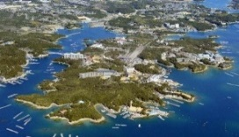
“G7 Ise-Shima Vision on Global Health” The Outcome of the G7 Ise-Shima Summit Health Agenda and Japan’s vision on UHC 2030 June 22, 2016 at InterContinental Hotel Geneva
Ambassador Koichi AIBOSHI
Assistant Vice-Minister / Director General for Global Affairs
Ministry of Foreign Affairs of Japan
Notes:
Honorable Deputy Minister Hagos, Distinguished Guests, Ladies and Gentlemen,
Thank you very much for providing me this opportunity to present the outcome of the G7 Ise-Shima Summit Health Agenda on the occasion of the very first multi-stakeholders’ meeting to launch the process of transforming IHP+ to UHC2030. My name is Koichi Aiboshi, I’m the Assistant Vice-Minister for Global Affairs and my Bureau is in charge of global health policy and diplomatic strategy including this G7 health agenda negotiation.
Today, I would like to share with you how we have been working on to produce the “G7 Ise-Shima Vision on Global Health,” an official G7 document negotiated by the Sherpas, the path towards materializing this result, and Japan’s vision and commitment on global health including UHC2030.

Slide 2
Agenda
・Global Health and Japanese Diplomacy
・Key milestone
-UNGA side event
-PM Abe’s article on the Lancet
-UHC Conference and Global Fund in Tokyo
-G7 Health Experts Meeting (1st and 2nd)
・Japan’s initiative in G7 Presidency: Leader’s Declaration, Financial Commitment and “G7 Ise-Shima Vision for Global Health”
・Way forward
Notes:
First, I’ll start with a bit of the background on why Japan has put so much importance on global health in its diplomacy. Then, I’ll introduce the process of consolidating the ideas among G7 as well as consultation with the stakeholders within Japan reflecting back on some of the key milestone events before and during the Japan’s Presidency for G7, and present the outcome of the Ise-Shima Summit Health Agenda, including the Leader’s Declaration, “G7 Ise-Shima Vision for Global Health”.
Finally, I’ll touch upon our next challenges and opportunities to realize and implement this G7 initiative.

Slide 3
Global Health and Japanese Diplomacy
・Japan prioritizes global health in its diplomacy
---”Global Health Policy 2011-2015” ”Japan’s Strategy on Global Health Diplomacy” in 2013
--- “Basic Design for Peace and Health” in 2015 (new global health policy)
・The concept of ”Human Security”
“Protecting the vital core of all human lives in ways that enhance human freedoms and human fulfillment” (Commission on Human Security 2003)
---Japan has been a leading advocator of this concept
---Leads to “no one left behind”, which is the basic principal of SDGs
---“Health” is the most crucial and indispensable element
Notes:
I’ll begin with the reasons why global health is so crucial for Japanese diplomacy.
Firstly, Japan has been a leading advocator of the concept of “Human Security,” identifying it as the fundamental principle for its ODA. According to the UN Commission on Human Security, Human security is “to protect the vital core of all human lives in ways that enhance human freedoms and human fulfillment.”
From that definition, this concept leads to “no one left behind,” which is the basic principle of the SDGs adopted last year.
And to achieve human security, health is the most crucial and indispensable element, as it constitutes the basis of the life of human being.

Slide 4
Global Health and Japanese Diplomacy
・Our experience to share
---Established health insurance system to cover all citizens in 1961, good outcome of relatively low costs so far. (One of the examples of universal health coverage)
---Example of outcome: Life expectancy(female)
Life expectancy of G7 countries 1950-2010
Notes:
Secondly, Japan has achieved a society where people enjoy good health and longevity of life. Japan established health insurance system to cover all citizens in 1961, and the healthy workforce contributed to boost its economy and it ultimately led to the rapid economic growth after the World War II.
Japan is facing the front-line challenges in health such as ageing population and health system for the first time in the world. It also has much experience in the treatment and prevention of non-communicable diseases, as well as combatting infectious diseases. With such rich and broad experience on addressing domestic health challenges, together with its technologies and expertise accumulated in the health area, we believe we are in the very unique position to contribute to the improvement of global health.

Slide 5
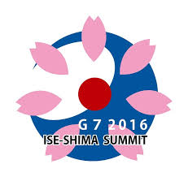
Global Health and Japanese Diplomacy
・Japan has taken up health as its top priority in G7/G8
Kyushu-Okinawa (2000) | Highlighted “infectious diseases” as the main theme of the G8 for the first time. Paved the way to the establishment of the Global Fund in 2002
Hokkaido-Toyako (2008) | Highlighted the importance of Health System Strengthening
Ise-Shima(2016) | Health emergency (After Ebola) UHC (SDGs) AMR
Notes:
Now I turn to the Japan’s previous G7/8 health agenda as well as the process of forging the Ise-Shima health agenda outcome this time.
G7/8 has been a central stage for Japan to promote global health. The 2000 Kyushu-Okinawa Summit was the first summit leaders took up the issue of “infectious diseases” as its main theme, and these discussions led to the establishment of the Global Fund to Fight AIDS, Tuberculosis and Malaria in 2002 and contributed to the achievement of the Millennium Development Goals. At the 2008 Hokkaido Toyako Summit, leaders agreed on comprehensive measures to strengthen health systems, including measures against infectious diseases and improving maternal and child health.
Since 2008, there were many challenges and developments on global health in the world. Two most significant events were, Ebola outbreak and the adoption of SDGs.
The world needs to change fundamentally to adapt to these emerging challenges and new opportunities.
Against these backgrounds, the G7 Ise-Shima Summit provided an ideal opportunity to advance international engagement for health-related SDGs and tackle public health emergencies. .

Slide 6
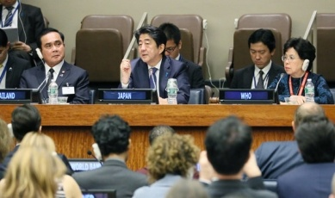
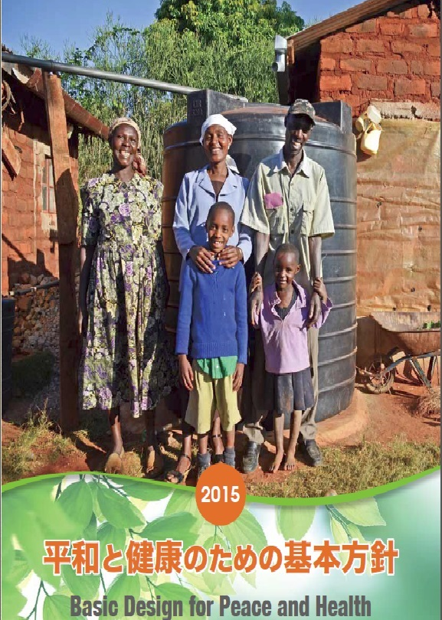
Key Milestones
～Japan’s contributions to UHC 2030～
September 2015 UN General Assembly Side Event
“The Path towards Universal Health Coverage”
<Policy framework was consolidated when SDGs adopted>
Japan’s global health policy:
“Basic Design for Peace and Health” published in Sep. 2015
“I emphasize here the need to bring together expertise and resources from
donor countries, the international organizations including WHO, the Global Fund and World Bank, and the private sector to establish an international alliance to support developing countries to achieve stronger health systems. I hope that today’s event will become an important step forward on the road to promote the formation of such an alliance to strengthen health systems towards the ultimate goal of achieving UHC. Japan is ready to lead this global discussion.”
---Statement by Prime Minister Abe, on the occasion of the UNGA side event
Notes:
There were several key milestones to lead to the outcome of the G7 health agenda, together with other G7 colleagues. The process and preparation started well before the beginning of our Presidency.
In September 2015, Japan hosted a side event “The Path towards Universal Health Coverage,” in the margin of the UN General Assembly. At this event, Prime Minister Abe emphasized the need to bring together expertise and resources from donor countries, the international organizations and CSOs towards the achievement of UHC, and therefore suggested to form a international platform. Here, the budding idea which ultimately led to the establishment of UHC 2030 was emerged. SDGs was adopted at the same UNGA.
The event also coincided with the publication of “Basic Design for Peace and Health,” Japan’s new global health policy.

Slide 7
PM Abe’s Article on the Lancet
～Japan’s contributions to UHC 2030～
“Japan's vision for a peaceful and healthier world” December 12, 2015
<The main points of the article>
➣ Japan has been an advocate of human security, which underlies Japan’s policy of Proactive Contribution to Peace, and has taken action in support of this principle. Japan regards health as an indispensable element of human security.
➣ The 2030 agenda for sustainable development, which was adopted at the United Nations General Assembly this year, includes universal health coverage, to which Japan attached great importance during the negotiation process.
➣ Japan’s global health priorities are; (i) To construct a global health architecture that can respond to public health crises (ii) To build resilient and sustainable health systems to promote health throughout the life-course, addressing the challenge of antimicrobial resistance. Japan, the world’s fastest-ageing society, is pioneering the challenge of ageing by extending healthy life expectancy while maintaining a sustainable health system, on the basis of a life-course approach for all generations.
➣ With the G7 presidency in 2016, Japan is determined to contribute further to global health.
Notes:
Then, towards the end of 2015, Japan took many actions on global health. In December 12th, Prime Minister Abe contributed an article titled “Japan’s vision for a peaceful and healthier world” in the Lancet magazine.

Slide 8
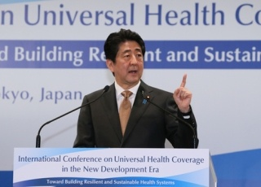
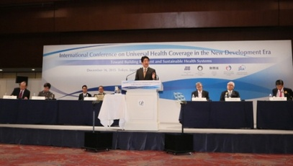
UHC Conference in Tokyo
～Japan’s contributions to UHC 2030～
December 16, 2015 Japan hosted an international conference
“Universal Health Coverage in the New Development Era:
Towards Building Resilient and Sustainable Health Systems”
“The 2030 Agenda includes numerous health related targets to be achieved including the achievement of Universal Health Coverage (UHC) which Japan has long been promoting as well as a wide range of countermeasures against diseases including infectious diseases. Next year, Japan will be the first country to assume the G7 Presidency after the adoption of the new Agenda……I intend to take up health as a priority agenda at the G7 Ise Shima summit, and I would like to lead the discussion on the health challenges that the world faces in close cooperation with the other G7 countries. …… To develop such health systems in accordance with the unique circumstances of each respective country, strong political will, clear plans, and the mobilization of adequate financial and human resources on a global scale including among developing countries are indispensable. It is also important that relevant international organizations and donors share a common vision and strengthen their collaboration.” ---Statement by Prime Minister Abe, on the occasion of the UHC conference
Notes:
In the same month, Japan hosted an international conference “Universal Health Coverage in the New Development Era: Towards Building Resilient and Sustainable Health Systems” in Tokyo as well as the Global Fund’s 5th Replenishment Preparatory Meeting. At the meeting, Prime Minister Abe expressed his intention to take up health as a priority at the Ise-Shima Summit. There, he reiterated the importance to share a common vision and strengthen the collaboration among relevant stakeholders, and made it clear that Japan is committed to lead the discussion, putting importance on Japan’s long advocated principles such as UHC, and strengthening the global health structure against public health emergencies such as Ebola.

Slide 9
UHC Conference in Tokyo (cont’d)
More than ３００ participants
-Margaret Chan, Director-General, WHO;
-Jim Yong Kim, President, World Bank
-Bill Gates, Co-chair, Bill & Melinda Gates Foundation
-Babatunde Osotimehin, Executive Director, UNFPA
-Mark Dybul, Executive Director, The Global Fund to Fight AIDS, TB and Malaria
-Seth Berkley, CEO, Gavi, the Vaccine Alliance
-Ministers of African and Asian countries (Foreign Minister Tedros of Ethiopia, Health Minister Sakolsatayadorn of Thailand, Cabinet Secretary Macharia of Kenya, Dr. Kaloko, AU Commissioner for Social Affairs)
Key Messages
• The Ebola crisis highlighted the need for better preparedness to deal with health security threats.
• The focus on preparing for large-scale crises should not deter from the everyday goal of strengthening health systems and ensuring that all people have full access to health services.
• UHC has gained ground as a mechanism for achieving equity in health and for making health systems more resilient to crises.
• UHC requires an inclusive process. UHC also requires strong political will at the highest levels.
• Domestic resources should ultimately support the bulk of financing for UHC, but external assistance is still crucial in many countries.
Notes:
At the conference, more than 300 participants attended including Margaret Chan DG of WHO, Jim Yong Kim President of World Bank, Bill Gates, Osotimehin of UNFPA, Mark Dybul of Global Fund, Seth Berkley of Gavi, as well as Ministers from African and Asian countries. Global Health Leaders gathered in Tokyo and exchanged opinions and ideas aiming for better world of global health. Some of the key ideas evolved from the conference, which made the basis of the Summit discussion, and I want to highlight one of the messages, “UHC requires an inclusive process. UHC also requires political will at the highest level.” This message is also very relevant for UHC2030.

Slide 10
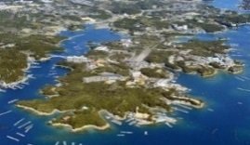
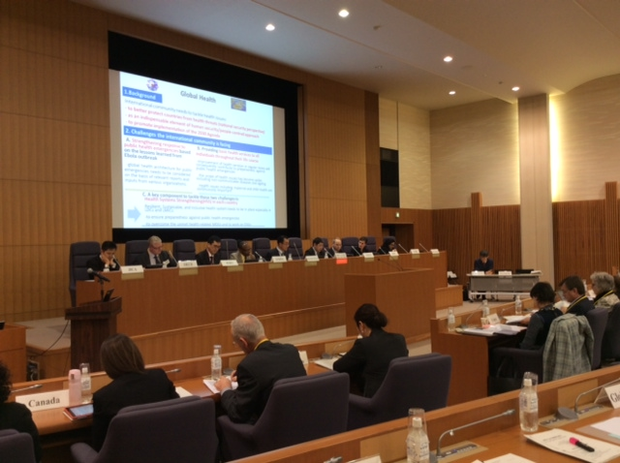
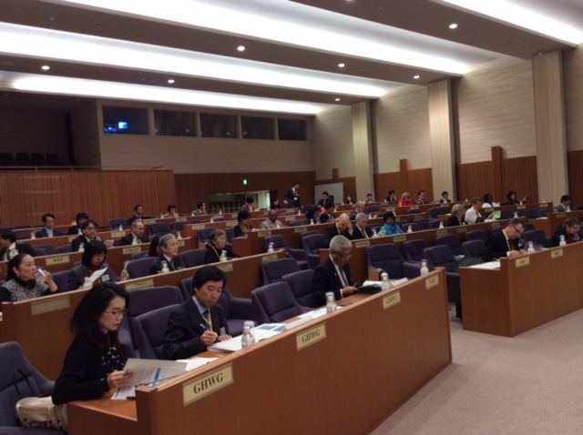
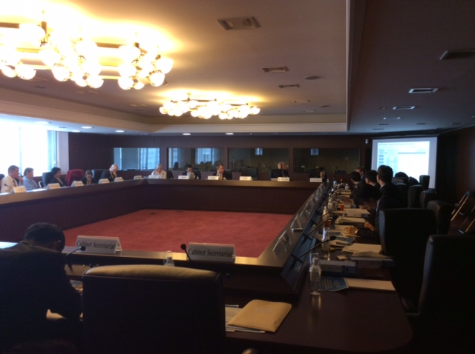
G7 Health Experts Meeting
～Japan’s contributions to UHC 2030～
January 2016: Japan assumed the Presidency of G7
January 18-19, 2016 1st Health Experts Meeting in Tokyo (incl. outreach)
March 31-April 1, 2016 2nd Health Experts Meeting in Tokyo
1st Health Experts Meeting
Attended by about 100 people, including G7 countries, The Government of Japan (Ministry of Foreign Affairs , Cabinet Secretariat, Ministry of Finance, Ministry of Health, Labour and Welfare (MHLW), Japan International Cooperation Agency (JICA)) and Resource groups including international organizations, academia, NGOs
(Gates Foundation, Global Fund, Gavi, IPPF, OECD, UNDP, UNFPA, UNICEF, WFP, WHO, World Bank, Global Health Working Group, G7 Network of Health-related NGO in Japan, UNSG’s High-level Panel on Global Response to Health Crises, Harvard-LSHTM Independent Panel on the Global Response to Ebola, NAM Commission on a Global Health Risk Framework for Future, the Advisory Group on Reform of WHO’s work in Outbreak and Emergencies)
2nd Health Experts Meeting
Intensive discussion among G7, as well as WHO (DDG Bruce Aylward, Director Edward Kelley), World Bank (Dr. Tim Evans) as the presenters for special session and Dr. Nabarro contributed by video message
Notes:
Japan assumed the Presidency of G7 in January 1st 2016, and accelerated the preparation process for the Summit. In January, we hosted the first health experts meeting in Tokyo, which was attended by very variety of stakeholders, ranging from the G7 counterparts, other Ministries, international organizations, academia and NGOs. Appreciating those valuable inputs, the 2nd health experts meeting and the following exchanges focused on the negotiation among the G7 of the contents of the outcome. The fruit of these meetings eventually went to the Sherpa Office, and negotiated in the Summit process.
And finally, in the end of this long, intense process of negotiation and preparation, the Ise-Shima Summit was held in May 26-27.
As we have seen, the process of creating the G7 Ise-Shima health agenda was not exclusively done by G7, but rather very inclusive process itself. So I think, it is not coincident at all that Ise-Shima Leader’s Declaration states the support for UHC2030, which is indeed an inclusive and evolutional platform for all to aim at UHC.

Slide 11
“G7 Ise-Shima Vision for Global Health”
3 key issues
Objectives
Promote R&D and innovation in all areas
The G7 leaders commit to:
1
Reinforcing the global health architecture to respond to public health emergencies
Leveraging lessons from the Ebola crisis, lead the strengthening of response to public health emergencies by the international community.
Further promote UHC, which is a key to address the broader health issues faced by the international community.
Strongly commit to the health-related SDGs as the first G7 Summit Meeting after the adoption of SDGs.
2
Attaining UHC with strong health system and better preparedness and prevention
3
Strengthening response to AMR
Notes:
In the final outcome, the Leader’s Declaration and “G7 Ise-Shima Vision for Global Health” took up three pressing issues on global health: a stronger response to public health crises, universal health coverage, and antimicrobial resistance, based on the notion that health is essential for people to lead happy and fulfilling lives.
, G7 decided on addressing Infectious diseases, such as the Ebola virus, cause significant human and economic losses and pose major threats to states and society. Also with changes in population and economic development, both the G7 and developing countries share the challenges of an aging society as well as non-communicable diseases such as cancer and diabetes.
And most importantly, the Ise-Shima Summit is the first G7 meeting since the UN adopted the 2030 Sustainable Development Goals (SDGs), promoting global health initiatives is essential in “ensuring that no one is left behind,” a fundamental principle of the SDGs. “Ensuring that no one is left behind” is an important concept to protect and empower individual people, and one that Japan has emphasized. It is in line with the idea of human security, building a strong society and nation.
And UHC, which is one of the targets of SDGs, is indispensably important to realize that principle of “no one left behind” in the health area.

Slide 12
“G7 Ise-Shima Vision for Global Health”
2
Attaining UHC with strong health system and better preparedness and prevention
☆Ise-Shima Summit is the first G7 Summit which highlighted UHC
Promote UHC in developing countries and enhance prevention and preparedness against emergencies
Support the establishment of UHC 2030 as a strengthened international framework to coordinate efforts of relevant stakeholders and various initiatives
Commit the G7’s effort for strengthening health systems in LIC/LMICs
Notes:
I must point out that, this is the very first G7 Summit which highlighted UHC for the first time in its history. In the UHC part, G7 shared the view that universal health coverage (UHC) guarantees the provision of basic health services for all people throughout their lives. UHC has become a shared international goal in the form of SDG targets. In order to push forward global efforts for, achieving UHC, G7 agreed on supporting the establishment of UHC 2030, as a strengthened international framework to coordinate efforts of relevant stakeholders and various initiatives.

Slide 13
“G7 Ise-Shima Vision for Global Health”
UHC 2030: Bring everybody’s expertise together
・ A strengthened international framework to coordinate and consolidate efforts toward the achievement of UHC under various fora/initiatives, including disease-specific efforts, as well as to leverage the expertise of all relevant stakeholders including CSOs.
・ To seek to ensure the IHP+ principles to accelerate equitable and sustainable progress toward UHC through:
(i) consolidating political momentum;
(ii) creating a common understanding of HSS and UHC;
(iii) sharing the common understanding on a minimum set of measurable indicators of HSS and UHC drawing from pre-existing ones; and
(iv) ensuring accountability by tracking progress toward UHC with these indicators, with possible support of initiatives such as the Roadmap Healthy Systems, Healthy Lives.
3) Continue to encourage and support the earliest possible establishment of the partnership in consultation with countries, to promote UHC, and to leverage support for health system strengthening in the most vulnerable countries.
Notes:
What do we want to achieve through UHC2030? The objectives, mandate, structure, governance and many other details of UHC2030 should be further discussed and decided by the existing and emerging members of the IHP+ in the consultation process including through this launching event and discussion today and tomorrow.
I would just like to introduce some of the expectations raised by the G7 for the role of UHC2030. UHC2030 would be a strengthened international framework to coordinate efforts toward the achievement of UHC under various fora/initiatives, including disease-specific efforts, as well as to leverage the expertise of all relevant stakeholders including CSOs.
It would seek to ensure the IHP+ principles to accelerate equitable and sustainable progress toward UHC through:
(i) consolidating political momentum;
(ii) creating a common understanding of HSS and UHC;
(iii) sharing the common understanding on a minimum set of measurable indicators of HSS and UHC drawing from pre-existing ones; and
(iv) ensuring accountability by tracking progress toward UHC with these indicators, withpossible support of initiatives such as the Roadmap Healthy Systems, Healthy Lives.
Sharing good examples as well as common challenges could also be one of the important functions of UHC2030.

Slide 14
Way forward
1
Facilitate the process toward the implementation of SDGs including UHC, domestically and internationally
May 20: Establishment of SDGs Promotion Headquarters (chaired by PM Abe)
June 22-23: Launching of the UHC 2030
2
Political advocacy as well as the implementation of the vision at national, regional and global level, leveraging key international events
TICADVI (The 6th Tokyo International Conference on African Development) in Nairobi, Kenya (August 2016)
G7 Health Ministers Meeting in Kobe, Japan (September 2016)
UNGA and other international events
3
Bilateral and regional cooperation through ODA and technical cooperation
Implementation of “Ise-Shima Vision” which also commits to support for health system LICs/LIMCs towards UHC
Notes:
Finally, I would like to touch upon the way forward to realize the G7 commitment.
Firstly, Japan is committed to facilitate the implementation of SDGs including UHC, domestically, and internationally. In May 20th, Prime Minister Abe held the 1stmeeting of the Sustainable Development Goals (SDGs) Promotion Headquarters, which aims to enhance the domestic collaboration and coordination among the Ministries, local governments, private sector and NGOs towards the implementation of SDGs, as SDGs and UHC require cross sectoral effort for its achievement.
At the international level, of course, today’s launching conference for UHC2030 is very first action after the G7 Summit marking significant milestone.
Secondly, we will have TICADVI in August. This conference is not only between Japan and Africa, but the whole international community is the stakeholder. TICADVI will be the first international conference after the G7 Summit to implement the comprehensive “Vision” shown at the Summit.
And also, G7 Health Ministers Meeting is going to be held in Kobe, Japan in September and will follow up and deepen the discussion on the elements of the Summit.
We will continue political advocacy for the promotion of UHC, in various occasions, including UN General Assembly in September.
Thirdly, the bilateral and regional cooperation through Japan’s official development assistance. “Ise-Shima Vision for Global Health” also commits the support for health system strengthening for individual country or region, and Japan will continue to assist countries for its development of health sector, respecting each context unique to the country or region, as well as country ownership.

Slide 15
Thank you very much!
Notes:
In conclusion, I would like reiterate my appreciation for the combined effort and contributions of all for generating this movement of UHC 2030, and welcome and congratulate on the launching conference of UHC2030. I would also like to commend the excellent work of IHP+ Steering Committee and the Core Team to prepare the conference right after the Ise-Shima Summit, which encouraged the earliest establishment of this partnership. My special gratitude also goes to today’s participants, those who have joined the launching process. I sincerely hope that the outcome of the G7 Ise-Shima Summit will chart a path for the international community toward achieving UHC, marking another milestone in the efforts in global health. Japan will continue to be active on this field, I look forward to the fruitful discussions throughout this 2-day conference.
Thank you very much for listening.

