Slide 1
Global challenges and opportunities for IHP+ partners

Slide 2
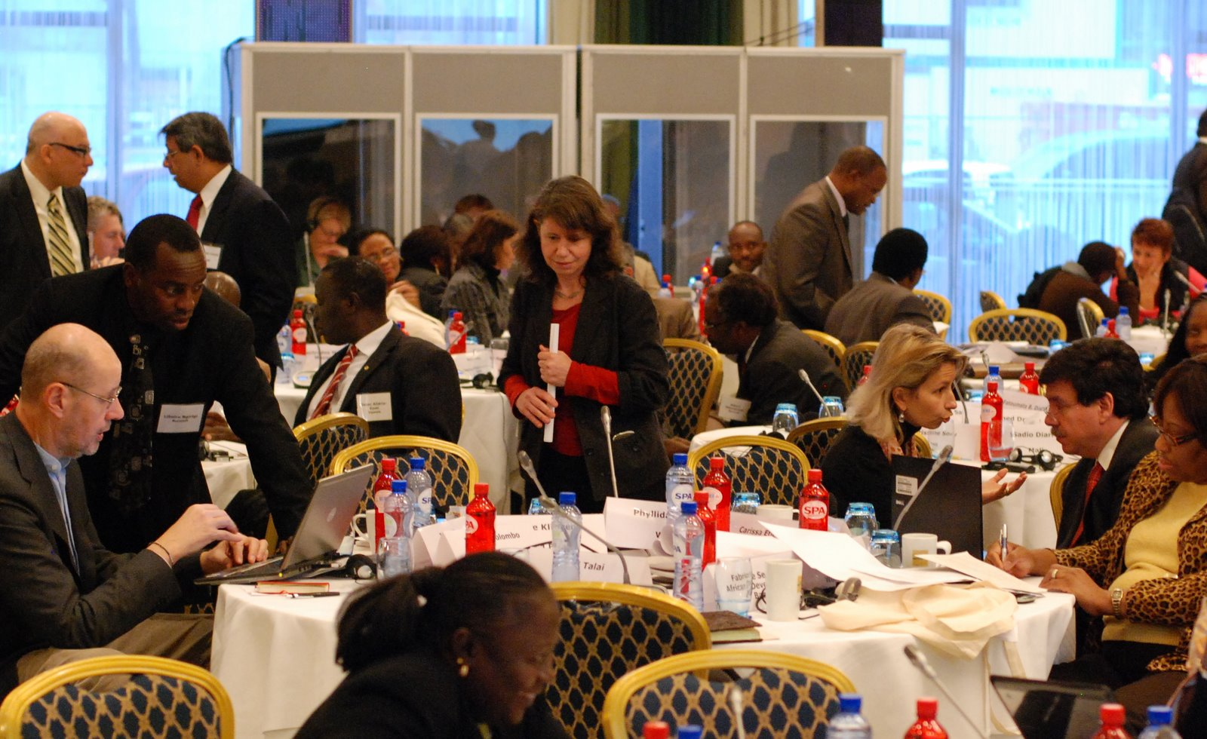
2 years ago, IHP+ partners met in Brussels in the midst of the global economic crisis
  Key messages from that meeting stated that:
  Aid effectiveness matters as much, if not more, in challenging financial times
  IHP+ partners need to consolidate and accelerate progress

Slide 3
Some progress has been made, however, we still have a lot of work ahead
Progress towards MDG 4,5 & 5 in IHP+ countries
Source: WHO, 2012

Slide 4
IHP+ partners work in a shifting global context
New global stakeholders
  The BRIC countries play an ever growing role in shaping the global development agenda
  The Private Sector/Non State Actors are seen as important partners for delivering on health targets in an increasing number of countries
Changes in global aid architecture
  The Global Fund has adopted a new strategy following a year of significant change
  The UNSG’s “Every woman every child” and related maternal and child initiatives have put much needed focus on MDG 4&5
Milestone meetings
  The 2011 High Level Forum on Aid Effectiveness in Busan initiated a shift towards the broader notion of development effectiveness, with country ownership, inclusion and accountability for results at its core
  The Harmonization for Health in Africa (HHA) Tunis high level conference with MoF and MoH emphasized the urgent need for greater domestic accountability, greater value for money in the delivery of health services in Africa and reduced dependence on foreign aid and instead take advantage of the continent’s impressive economic growth and demographic dividend

Slide 5
In many countries, dependency on external resources has decreased over the past years*
External resources on health as % of Total Health Expenditure, Examples
  As domestic resources grow, it becomes increasingly important to take into account both domestic and external resources for health
  Similarly, accountability for results must be enabled through both domestic and global accountability mechanisms
-25%
-16%
-13%
-36%
-33%
Source: WHO, NHA database

Slide 6
Yet, the health sector remains crowded and issues of duplication and fragmentation are still very real
Key external stakeholders in Mali
International CSO’s: Medecins Sans Frontieres, PSI, Helen Keller, Plan International, Red Cross
UN Family: UNAIDS, UNFPA, UNICEF, WFP, WHO and the World Bank
6 EU Countries:
Belgium, Spain, France, Luxembourg, Netherlands, Sweden
Large bi-laterals: Canada, China, Japan, USAID
Global initiatives: GAVI, Global Fund

Slide 7
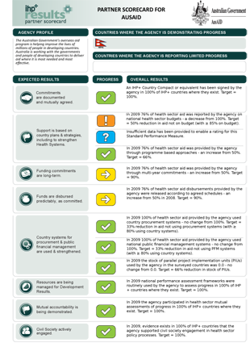
2012 IHP+ Results show some progress, but no step change development effectiveness
  Many countries are strengthening leadership, governance and country systems for health
  Development partners have consolidated efforts to align behind “one plan”, however, there has not been the expected increase in their use of country systems, especially financial management and monitoring platforms

Slide 8
There is real momentum for accelerating progress in the 1000 day countdown towards the MDGs
  Renewed momentum amongst Heads of Agencies and commitment to take action based on your feedback and recommendations from this meeting
  IHP+ growth from 27 to 56 signatories with engaged CSO’s, committed to one national, well coordinated health plan for which results are measured
  Greater public and international demand to demonstrate results and value for money

Slide 9
Over the coming days, let us all challenge ourselves to distill feedback and recommended action
  What concrete actions are needed?
  Will they address really important problems at the country level?
  What needs to be done by
    Heads of Agencies
    IHP+ core team
    You?
  How can it be taken forward over the next 1000 days?
In every session, ask yourself:

