Slide 1


What has changed in
5 years ?
Overview of progress in implementing IHP+ Global Compact commitments
Nairobi, 12th December 2012
Strengthening Accountability to Achieve the Health MDGs

Slide 2
5 key questions
Are countries leading the development of health sector plans and policy frameworks, and are development partners following this lead?
Is there more money for health and are funding sources becoming more predictable?
Are country financial management and procurement systems becoming more robust and are development partners making better use of these systems?
Is health sector performance being jointly monitored and are health results improving?
Have development partners made more progress in countries that have participated in IHP+ the longest?

Slide 3
1) Are countries leading the development of health sector plans and policy frameworks, and are development partners following this lead?
Headlines:
Establishing and supporting policy, planning, coordination frameworks is the area where most progress is evident
This has been where the IHP+ has placed most of its emphasis
Some issues of interpretation need attention, as does use of these frameworks to improve delivery of aid.
Commitments are documented; support is based on country plans | Government progress | Development Partner progress
Compacts or equivalent agreement exist | 12/19 have compacts 4 more are in progress | 77% of DPs with country representation signed Some issues of interpretation
Aid is reported on health sector budgets | 18/19 have plans 11/19 have current targets, budgets and have been ‘jointly assessed’ | Overall 59% of aid recorded on budget 8 out of 17 DPs met the target
Notes:
Two headline messages messages:
18 Countries have plans and 12 have compacts
77% DPs support compacts
Capacity development support is coordinated: 18/19 have plans (not necessarily for capacity development); Overall 90% (target achieved)
Aid is provided through programme based approaches: No equivalent indicator; Overall 81% (target achieved)

Slide 4
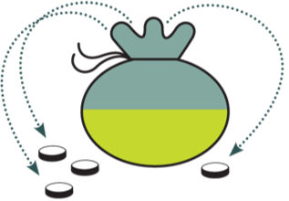

Donors putting their money ‘on budget’ for health
52%
52%
79%
61%
2007
2009
2011
2007 2009 2011
Note: figures shown above are for 10 countries and 15 DPs.
^{2DPa:} Aggregate proportion of partner support reported on national budgets
Notes:
For all 36 participants 2011 data, the figure was 59%.

Slide 5
Health sector plans and policy frameworks (cont)
Mutual accountability is being demonstrated | Government progress | Development Partner progress
Mutual assessments of progress are held | 13/19 countries have mutual assessments in place | 69% of DPs participate in mutual assessments where they occurred Some issues of interpretation
Civil society is meaningfully engaged | Government progress | Development Partner progress
Civil society is supported to engage in health sector policy and planning processes* | 14/19 countries said CS was involved at 4 key aspects of policy & planning process | All DPs reported providing support to CS, but not necessarily in every country
*A better measure of CSO engagement is needed

Slide 6
2) Is there more money for health and are funding sources becoming more predictable?
Headlines:
Partner countries made less than expected progress on improving health budget allocations and disbursements (Rwanda, Burkina Faso & El Salvador met target)
DPs made less than expected progress on multi-year commitments, and met the target on disbursing funds as committed.
Volume and predictability of funding | Government progress
Proportion of the national budget allocated to health | Government allocations to health increased in 9/19 countries 3 countries allocated 15% or more to health
Aid is released according to agreed schedules | 10/19 countries met the target to reduce the gap between allocation and disbursement
 | Development Partner progress
Commitments are for 3 years or more | DPs provide 76% of health aid through multi-year commitments (90% target) 10/17 DPs met the target for multi-year commitments
Aid is released according to agreed schedules | Overall 103% (target achieved)

Slide 7
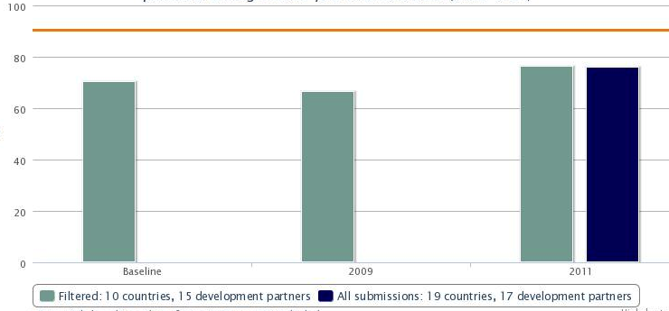
Limited Development Partner progress on increasing multi-year commitments

Slide 8
3) Are country financial management and procurement systems becoming more robust and are development partners making better use of these systems?
Headlines:
13/19 partner country PFM systems are getting stronger. Data on strength of procurement systems is weak.
DP use of country PFM systems where they are considered ‘strong enough’ is low (58% against an 80% target). Some signs of progress in earlier countries.
Measurement of use of procurement systems is challenging. DP use is low; likely to be an underestimate.
Country systems are used and strengthened | Government progress | Development Partner progress
Aid uses country procurement systems | Insufficient data to make firm statements | DP use of country procurement systems was low Likely to be underestimate Challenging to measure

Slide 9
Country systems (cont)
Country systems are used and strengthened | Government progress | Development Partner progress
Aid uses country public financial management systems | 13/19 countries PFM systems improved and/or were ‘strong enough’ for DP use 10 countries PFM systems scored 3.5 or more | Overall DP use of country PFM systems was 58% (in 10 countries where systems were ‘strong enough’). 5 DPs achieved the 80% target
Use of Parallel Project Implementation Units (PIUs) is reducing | No equivalent indicator | Number of PIUs fell from 64 to 39, but target not met.

Slide 10
13/19 countries PFM systems improved and/or were ‘strong enough’ for DP use
PARTICIPANTS IN 2010 & 2012
PARTICIPANTS ONLY IN 2012
0.5
0.5
0.5
0.5
1.0
1.0
1.0
0.5
0.5
0.5
0.5
Notes:
This is hard to understand quickly – can you colour code the rising countries from the declining countries – or simply colour code those over the line and those inside the line
LEFT HAND COG: TITLE – PARTICIPANTS IN 2010 AND 2012 IHP+RESULTS MONITORING
KEEP COUNTRY NAMES THE SAME.
FILL LEVELS AS FOLLOWS (5 IS COMPLETELY FULL – BURKINA FASO IS CURRENTLY SHOWING 4.5)
COUNTRY NAME FILL LEVEL (CHANGE SINCE BASELINE)
BURKINA FASO 4.5 (+0.5)
BURUNDI 3.0 (+0.5)
DRC 2.5 (NO CHANGE)
DJIBOUTI 3.0 (NO CHANGE)
ETHIOPIA 3.5 (NO CHANGE)
MALI 3.5 (-0.5)
MOZAMBIQUE 4.0 (+0.5)
NEPAL 2.5 (-1.0)
NIGER 3.5 (NO CHANGE)
NIGERIA 3.0 (NO CHANGE)
RIGHT HAND COG: TITLE – PARTICIPANTS IN ONLY 2012 IHP+RESULTS MONITORING
COUNTRIES AS LISTED BELOW. 1 SECTION WILL BE GREYED OUT – UNLESS IT’S EASY TO DIVIDE THE COG BY 9 INSTEAD OF 10?
FILL LEVEL SCALE IS THE SAME AS ABOVE. WE’LL NEED TO INCLUDE ‘NO DATA’ IN THE KEY AND PERHAPS COLOUR IT BLUE – SAME AS THE ? RATING SYMBOL?
COUNTRY NAME FILL LEVEL (CHANGE SINCE BASELINE)
BENIN 3.5 (-0.5)
EL SALVADOR NO DATA
MAURITANIA 3.0 (+1.0)
RWANDA 4.0 (+0.5)
SENEGAL 3.5 (NO CHANGE)
SIERRA LEONE 3.5 (NO CHANGE)
SUDAN 2.0 (-0.5)
TOGO 3.0 (+1.0)
UGANDA 3.5 (-0.5)
PLEASE DELETE THE SMALLER COG IN BOTH LEFT AND RIGHT HAND VERSIONS.

Slide 11
Aid flowing through country PFMs
Note: figures shown above are for 5 countries and 15 DPs.
Notes:
For 10 countries 2011 data, the figure was 58%.

Slide 12
Is health sector performance being jointly monitored and are health results improving?
Resources are managed for Results | Government progress | Development Partner progress
National performance assessment frameworks (PAF) are used | 13/19 countries reported having a PAF in place | 67% of DPs reported using the country PAF as the primary basis for assessing their health aid.

Slide 13
Have development partners made more progress in countries that have participated in IHP+ the longest?
5 countries included in analysis: Burundi, Ethiopia, Mali, Mozambique and Nepal
All had the 4 pillars in place (Compact + National Health Plan + Performance Assessment Frameworks + Mutual Accountability Process)
  All received more external aid recorded on their national budgets from 2009 to 2011 (Target met in Nepal, Mali and Mozambique)
A mixed picture on the extent of multi-year commitments by donors…
…but trend towards increased levels of predictability in 4 countries (2 even had significantly more aid delivered than planned for).
Notes:
SUGGEST FOR THIRD BULLET YOU STATE WHICH TWO HAD MORE MY COMMITMENTS AND WHICH DIDN’T
SUGGEST FOR FOURTH BULLET THAT YOU STATE PREDICTABILITY %S
5 countries (Burundi, Nepal, Ethiopia, Mali, Mozambique) joined the IHP+ as signatories to the Global Compact in 2007 and have had the longest period over which to demonstrate changes in how their Development Partners deliver aid to the health sector.

Slide 14
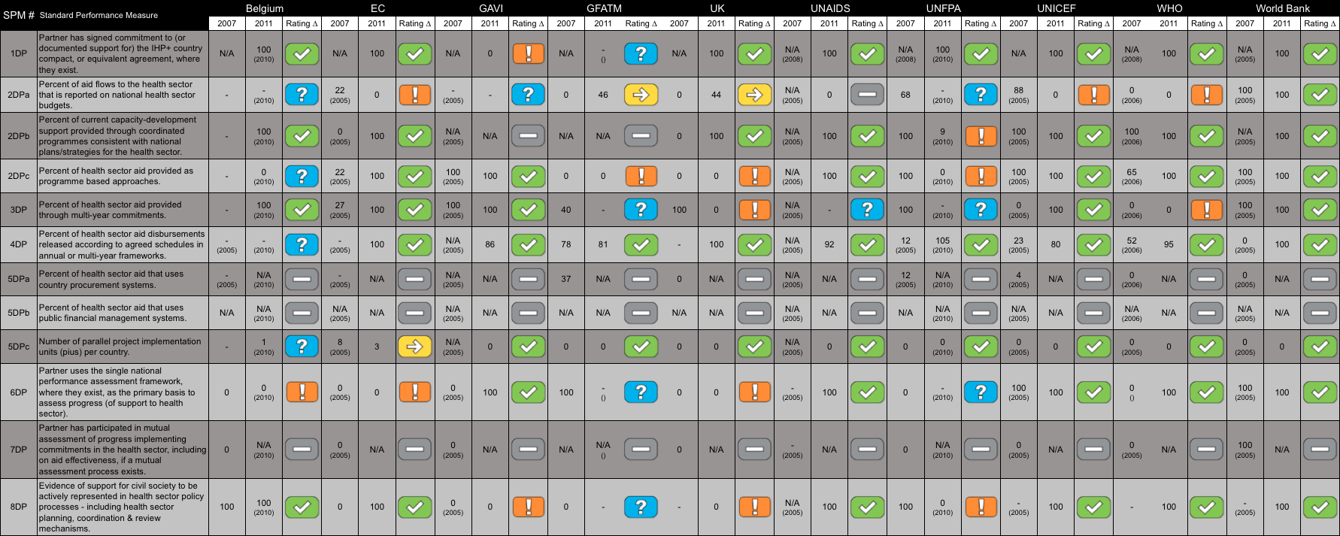
Progress in ‘first 5’ countries (eg Burundi)
Notes:
SUGGEST TO DELETE THIS – YOU HAVE SAID IN FACT ON THE NEXT SLIDE
INSTEAD COULD YOU INSERT A TABLE FOR ONE OF THE TOP 5 COUNTRIES SHOWING ALL DP PERFORMANCE ON 2DPA, 4DP, 5DPB – FROM BURGERCOM – AS AN EXAMPLE OF HOW VALUABLE THE TOOL CAN BE TO COUNTRIES TO KNOW WHICH OF THEIR DPS IS PERFORMING WELL ON WHICH INDICATORS

Slide 15
Headline conclusions
3 targets out of 12 DP targets met
Progress on policy/coordination framework - that countries have made progress and DPs begun to support
Less progress by DPs (albeit patchy) even though countries have strengthened PFM
Monitoring can be useful – if used
Notes:
– these were DP targets?
Good to show on this point that countries have made progress and DPs begun to support
Good to show on this point that less progress is by DPs although countries have strengthened PFM

Slide 16
Recommendations
Faster progress must be made to deliver more effective health aid that can contribute to health outcomes
Mutual accountability mechanisms must be used to drive improvements in health aid effectiveness
Future monitoring of health aid effectiveness should be owned by stakeholders and use improved indicators that measure what they need to know.

